Slide 1

Business Data Management Capstone Project
(Sep 2024)
Title: MediSmart: A Medical Store Analysis
Subtitle: Analyzing Operational Challenges at Akanksha Medicals
Presentation by:
Sanjana Gandhi
22f1001659@ds.study.iitm.ac.in

Slide 2
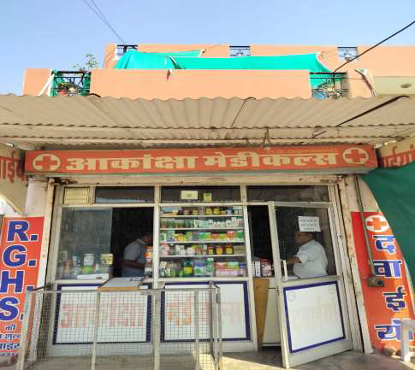
Introduction
This project focuses on analyzing the operations of Akanksha Medicals, a pharmacy in Alwar, Rajasthan, to identify and address key challenges like inventory mismanagement, inconsistent financial tracking, and limited use of data insights.
Akanksha Medicals is a pharmacy located in Kala Kuan, Alwar, established in 1994. It provides a variety of medical supplies, healthcare products, and wellness items.

Slide 3
Problem Statements
Inventory Mismanagement:
Overstocking of slow-moving items and understocking of high-demand products lead to inefficiencies.
Inconsistent Pricing:
Lack of clear pricing strategies affects profitability and customer trust.
Limited Customer Insights:
Minimal understanding of customer preferences hinders targeted marketing efforts.

Slide 4
Problem-Solving Approach
Inventory Management:
Analyze sales data to identify fast-moving and slow-moving products, and adjust stock levels accordingly.
Pricing Optimization:
Use scatter plots to evaluate pricing patterns and establish consistent, competitive pricing strategies.
Customer Insights:
Analyze demographics and purchasing trends to develop targeted marketing campaigns and improve customer engagement.

Slide 5
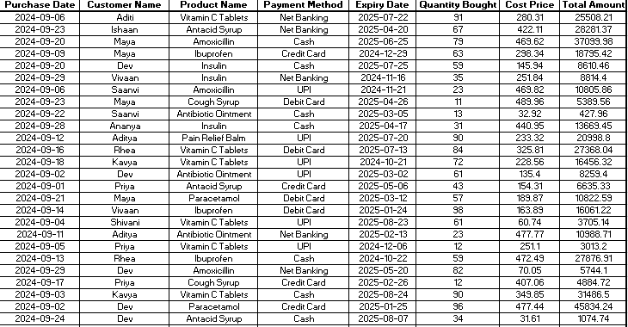
Data Collected
The project uses sales and purchase data from September 1 to September 30, 2024. The data includes:
Sales Data: Customer demographics, product names, quantities sold, selling prices, and payment methods.
Purchase Data: Product names, quantities bought, cost prices, and total purchase amounts.
This data helps identify trends, optimize inventory, and improve profitability.

Slide 6
Analysis Process
Analysis Steps:
Data Cleaning: Fixed missing values and removed outliers to ensure accurate analysis.
Descriptive Statistics: Calculated averages, trends, and variability in sales and purchase data.
Data Visualization: Used bar graphs, pie charts, and scatter plots to identify patterns and key insights.
Insights Generation: Analyzed customer preferences, product demand, and financial performance to make actionable recommendations.

Slide 7
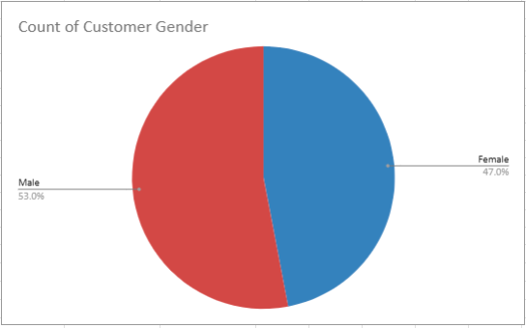
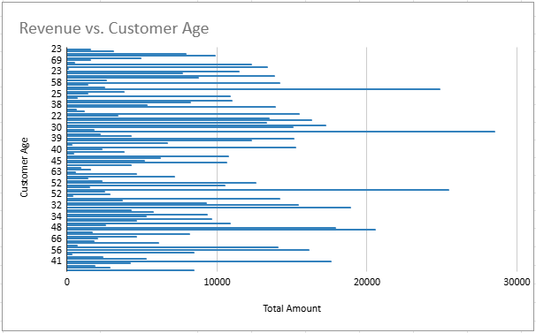
Results - Customer Loyalty
Males represent 53% of our customers, while females account for 47%.Customers in their late 30s, 40s, and 50s appear to have generated the highest revenue, while those in their early 20s and 30s tend to have lower revenue.

Slide 8
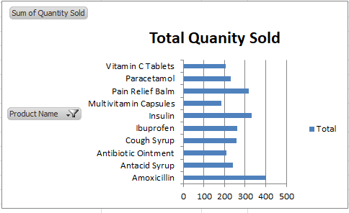
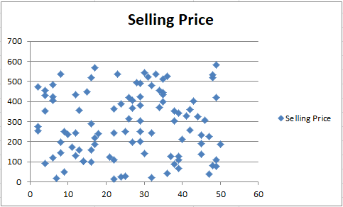
Results - Sales Analysis
The top-selling products include Antacid Syrup, Amoxicillin, and Paracetamol, with Antacid Syrup leading by a significant margin.The selling price of products shows significant variation, ranging from low-cost items to more expensive ones. There is no clear trend in pricing based on product quantity or other factors.

Slide 9
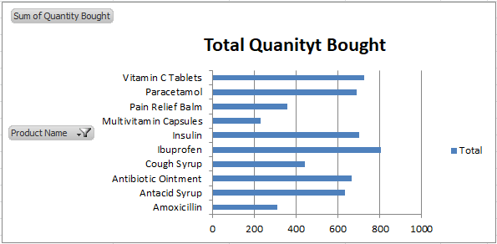
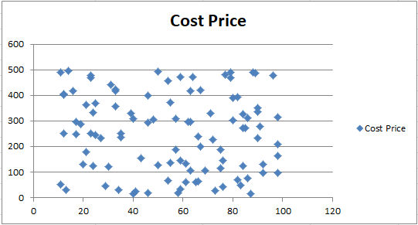
Results - Purchase Analysis
The top-buying products include Vitamin C Tablets, Paracetamol, and Ibuprofen. The cost price of products varies widely, ranging from low-cost items to higher-cost goods. No clear pattern is evident in cost prices concerning other variables like quantity.

Slide 10
Recommendation
Improve Inventory Management
Target Younger Customers
Promote Digital Payments
Stock more high-demand products and reduce overstocking of slow-moving items to avoid wastage.
Create promotions and marketing campaigns tailored to the younger demographic, which contributes most to sales.
Encourage the use of digital payment methods to align with customer preferences and market trends.

Slide 11
Conclusion
This analysis highlights key areas where Akanksha Medicals can improve its operations and profitability. By optimizing stock levels, targeting promotions effectively, and refining pricing strategies, the store can better meet customer needs while reducing inefficiencies. Implementing these data-driven recommendations will not only enhance profitability but also ensure sustainable growth and customer satisfaction in the long run.

